Slide 1
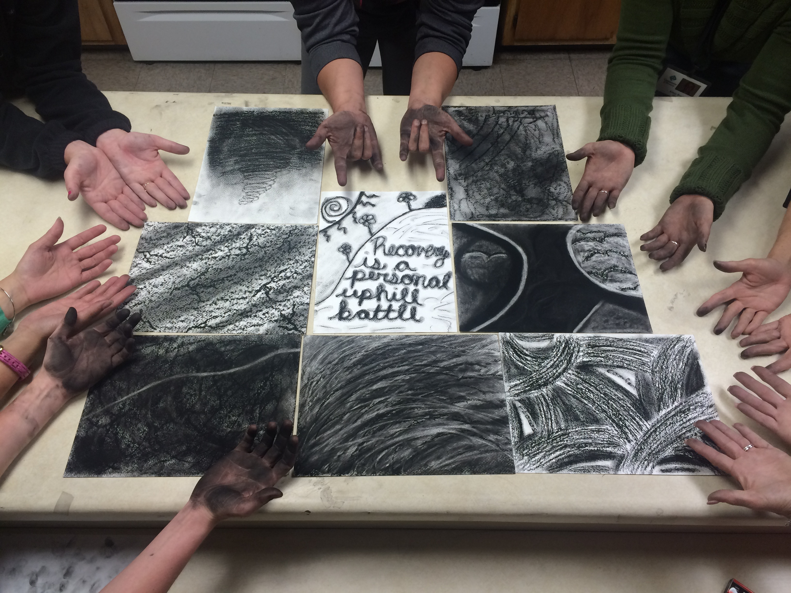

What is Creative Expression?
Expressive therapies reawaken creativity and provide the empowerment and self-awareness needed to grow in recovery to achieve successful, long term sobriety. Example categories:
Writing, Journaling, Poetry
Songwriting
Music
Art
Photography
Dance, Movement, Yoga
Design
Guided Imagery
Psychodrama
Crafts, Cooking, Gardening, Sand Play
What it is NOT:
creative expression is NOT –
What’s next?
Post two or three ideas of activities that you would like to use in your therapy sessions. Use any of the categories listed at left.
Then, read the posts of the other workshop participants and identify two activities that you would be willing to collaborate on developing and presenting.
After you are assigned a partner, work with that partner to develop and present the activity.
Objective & Audience: The Art Adds workshop participant will list ideas of activities.
Principles: social negotiation, collaboration, application of content, examples and non-examples.

